Slide 1

Inventor 2014
What’s New in the API
Brian Ekins Inventor API Product Designer

Slide 2
Nondisclosure Agreement
Today’s discussion is covered under your ADN Agreement with Autodesk.
The information we will be providing is highly confidential, and is to be shared within your company on “need to know basis” and to no one outside your company.
Autodesk makes no guarantees that anything presented or discussed will actually appear in the future.

Slide 3
What’s New in Inventor 2014?
64 new objects (with 840 new functions)
306 removed functions
450 new functions on existing objects
0 modified functions
Inventor 2012
48 new objects (with 619 new functions)
41 removed functions
303 new functions on existing objects
5 modified functions
Inventor 2013
43 new objects (with 390 new functions)
13 removed functions
141 new functions on existing objects
0 modified functions
Notes:
Not much , get involved , there is localize area, not a blob change, by the number is a OK release.

Slide 4
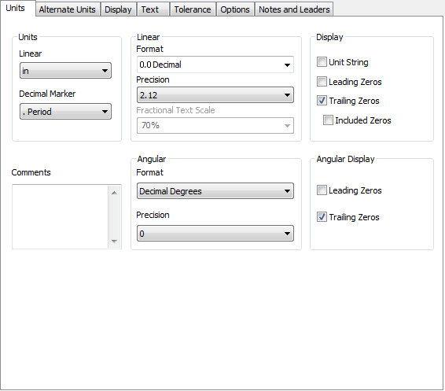
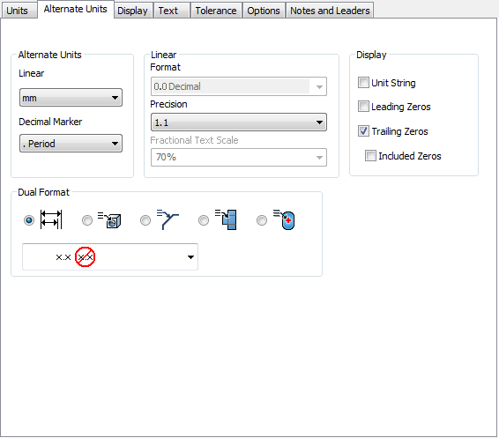
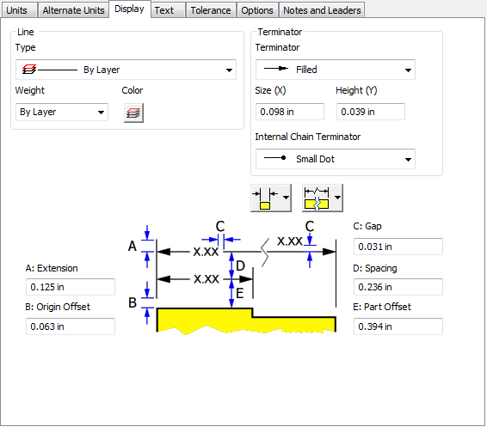
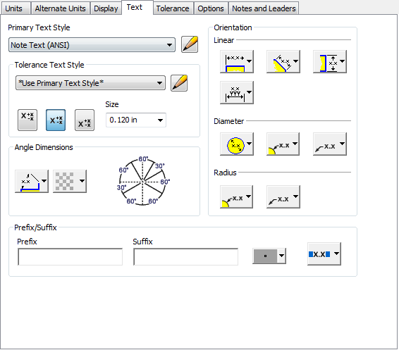
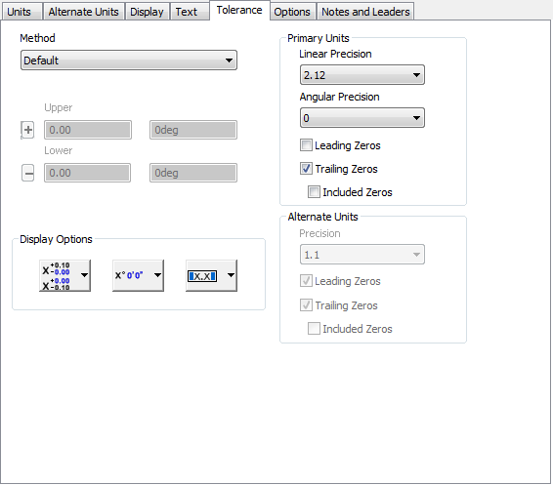
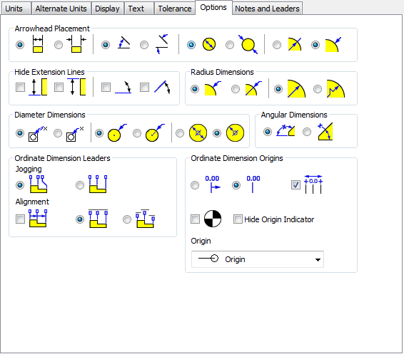
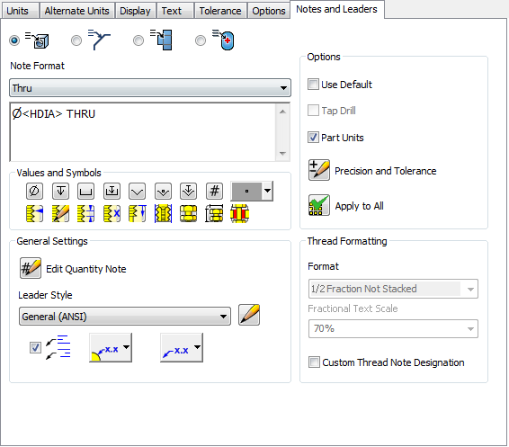
Drawings
Dimension styles are now almost fully supported.
Notes:
Before very limiated esposure in the dimension style. There are servela pages I with this stylr. It is complex to AP. On the toppest request of AND survey because of this, we exposed them, All of the various settings associated with dimension styles are now available through the API except for the settings on the “Notes and Leaders” tab.

Slide 5
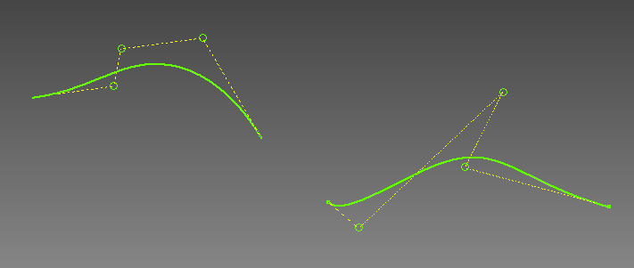
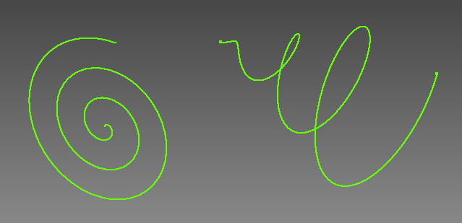
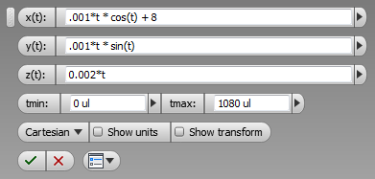
Sketch - Splines
Full API support for control point splines in 2D and 3D.
Full API support for equation curves in 2D and 3D.
Notes:
This is added in 2013 in ui, and now we added API support. In the past, we have only one way to create the spline by providing its points. Now, you can provide control points in a term of polyline. Inventor can draw spline with them. It is avaible in 2d or 3d.
Another is equation curve, you can define a 2d or 3d equationto draw the curve
The API now supports full creation and edit of control point spline and equation curves for both 2D and 3D sketches.

Slide 6
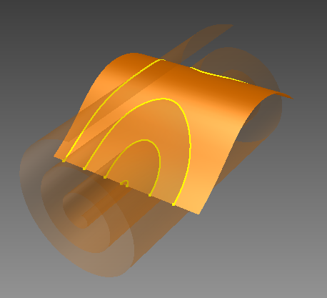
Sketch – 3D Intersection Curves
Full API support for intersection curves in a 3D sketch.
Notes:
This is also an abilyt added in the previous release and now supported by API
You can fine the interection of the surface and surface and create
3d sketch curves.
It is now all posible in API

Slide 7
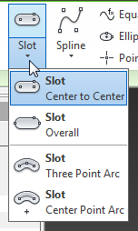
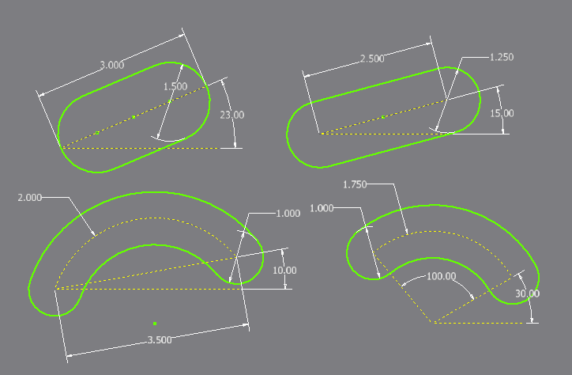
Sketch – Slots
New slot commands in sketch.
Full API Support.
Notes:
This is the new abilty of product and is avaible with API
Slot in sketches. The result is just a start, for convenient.
Somebody has requested such api a few releasea ago.

Slide 8
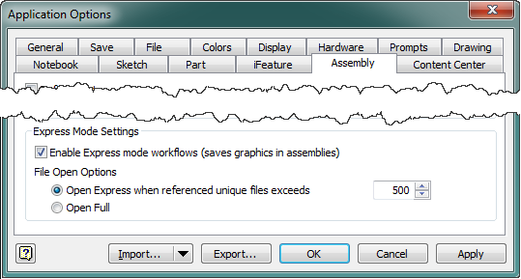
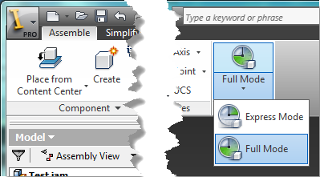
Assembly – Express Mode
AssemblyDocument.IsOpenExpress
Documents.LoadedCount
Application.AssemblyOptions
ExpressAssemblyMinimumUniqueDocuments
IsExpressAssemblyEnabled
Application.AssemblyEvents
OnLoadStateChange
Notes:
This is big ebanchment our engineer team has focused on in this year, There is not much API inpacted. Express mode, the idea is you can open
Aassembly in express mode that is a lot faster, how does it work
When you save the assembly, you can save it to express mode. It will save the
Graphics information to the assembly. now, if you arein the express mode
And open the assembly, you have the option to open in express or full mode. because the graphics info is there, you will not need to load the asembly, part
Load limiated info of the assembly, only the graphics.
In the UI, you have the swtich express . Full model, API basically expose
The option. We also added an event that to indicate if the mode is being swtiched
Ther
When the express mode, you cannot add more part until siwtching to full mode,

Slide 9
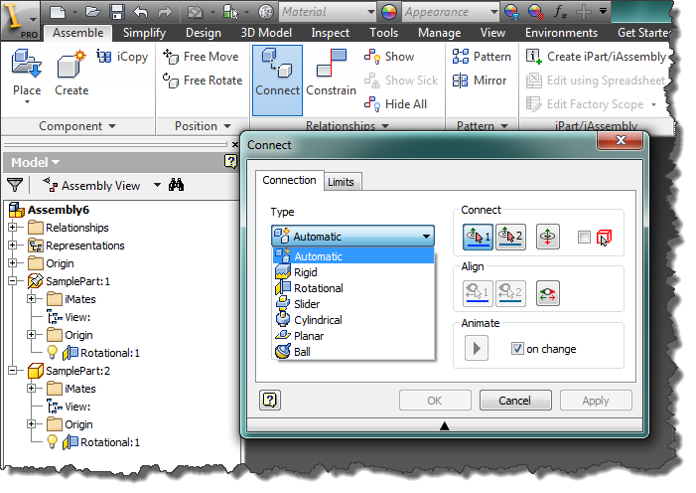
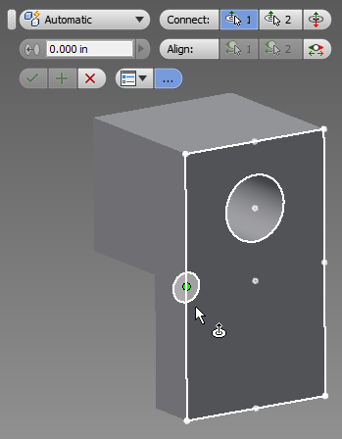
Assembly - Connections
Connections
Full API Support
Notes:
Connection we have had it in product already. Now in this release,It is pretty powerful.
We add API support. New type of constraint. Whole goal to it can be used to
It mainly really to be used than constraint.
In the language the engineers can understand.
You would not think a mate.
Connection is more real world a termolodyg . You can do something connectios with quite few constraints to have the effect. When you try to connection, Inventor will return some good graphics to indicate the relationship of the bodies.
There is full api in this realse.

Slide 10
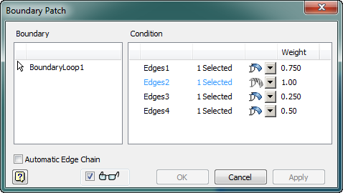
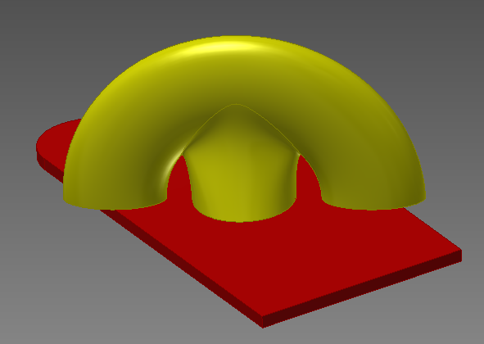
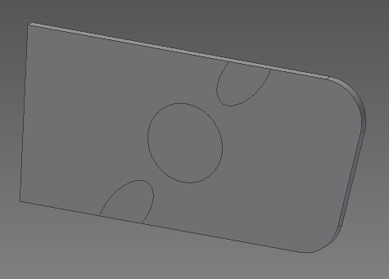
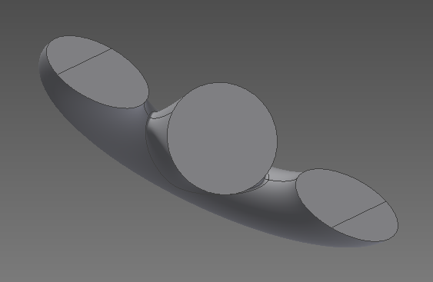
Part
UI and API support for work points at center of sphere.
Ability to specify edge weights in boundary patches.
Imprinting (API only)
Notes:
In parts, not too much. You can create workpoint at center of shphere. Control the patches weights.it is new in product and also API as well.
And also new function, API only is impritng. Not common use many developer
By comanny by some type s of analisys application that doing mesh as a solid, get better mesh , no gurantte where is the part connect. no here two two new body, transient
Two new bodies. Faces is spli with the part connected.

Slide 11
Consistent Materials – What’s Gone
The RenderStyle object is no longer used.
Hidden
Continues to function but should begin using new API
Not officially supported
The Material object is no longer used.
Hidden
Continues to function but should begin using new API
Not officially supported
Related methods and properties on other objects are hidden.
GetRenderStyle
SetRenderStyle
Material
Etc.
Notes:
So last relase intrduce we did not do anything wit API . The rendder stle aPI unheth it has limited access, most of seems ok, but not all. We expose the cm
The renderstyle is still there but we do not offical support anymore. now all old objects and methods are hidden.

Slide 12
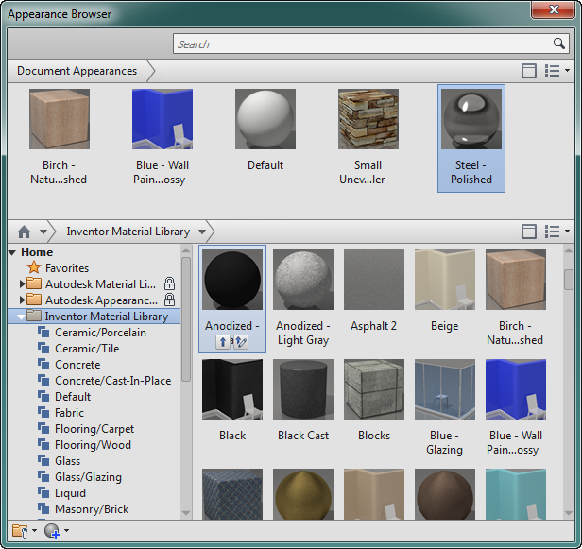
Consistent Materials – What’s New
Full API access to the new materials and appearances.
Consistent materials is more powerful and complex.
API is complex that previous API.
Notes:
CM has a lot of possbility but complex. Render style object, find the renderstly.e color, it is easy to know , create a new one.
It is not so easy as the old methods.
This is not the cae anymore . The way that we expose have a lib autodesk common libs, Lib across autodesk products. Libs contains assets. The contain Assets that can be aprranece or be a mateial. Asset is Just list of named values. Depens on the assest , So it is get a little complecaite
You have a librairies of collections of assets.
Very depends on what assets is
It is not self-document , desribing each type.
Also have a document assets. Be used to apply color to a face, then when you ar
Ding un the ui, you have ti list what is avaible in the document.
aPI can access the document, then this is just high level. Document is well written

Slide 13
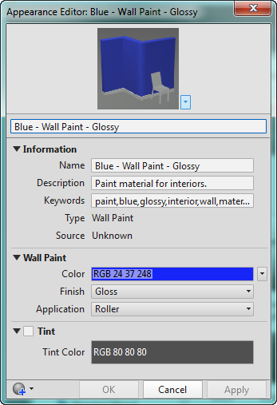
Consistent Materials – Continued
Library and Document assets.
Only Document assets can be edited and used.

Slide 14
Consistent Materials – Continued
Materials, Physical Properties, and Appearances are “Assets”.
An asset is a collection various types of named values:
Boolean
Choice
Color
Filename
Float
Integer
Reference
String
Texture
Notes:
Materials simplest assets. Name: combine the two: color,
Different types will values. For the middle. That will be documented.

Slide 15
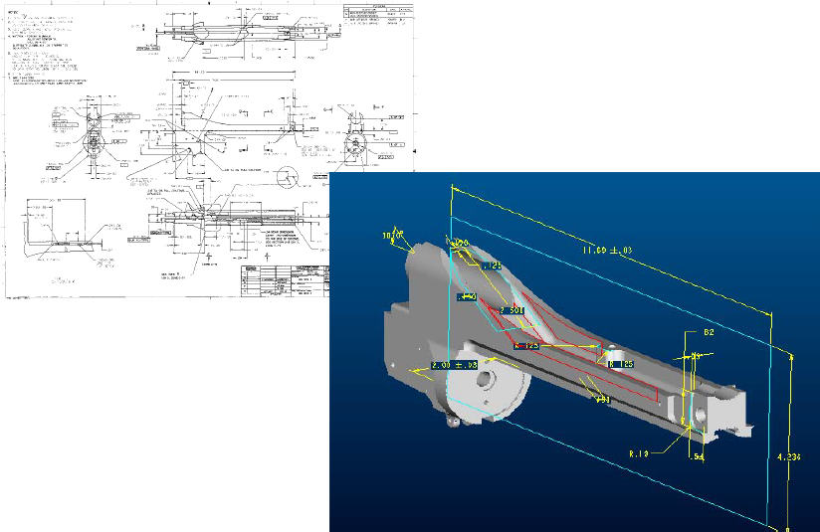
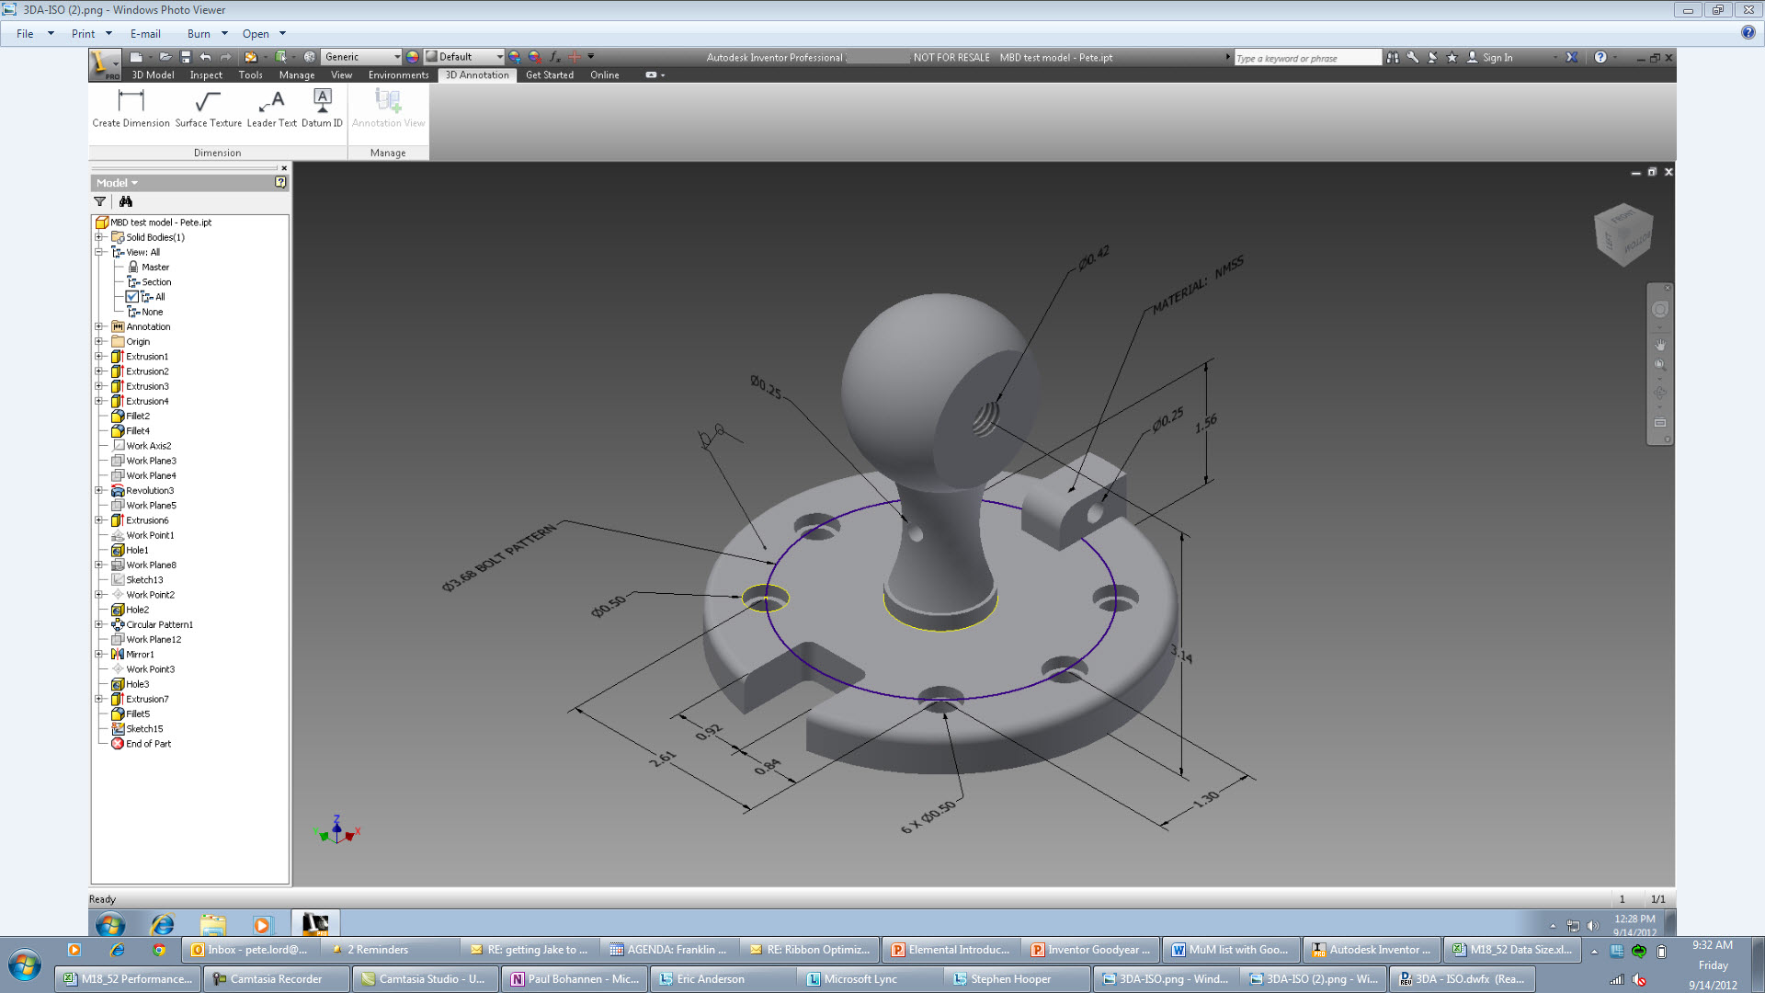
Model Based Dimensioning (3D Annotation)
Will be available mid-year to subscription customers.
There will be API support.
Notes:
Not coming in RTM but with sub customer. ideally imilated will be support
When it comes to be avaible.
Two: find the customer who are intested in and invesigate

Slide 16
Miscellaneous
Pack and Go
BIM Exchange
No longer delivered with Inventor but is provided as a free app on the Exchange store.
Updates to BIM Exchange to control origin and orientation of components.
VBA 7
Native 64-bit (Fast startup)
Runs in-process to Inventor on 64-bit (Fast execution)
Mouse wheel works to scroll.
Notes:
Packe go on the highest survey.
Exchange,

Slide 17
Today’s presentations…
ADN Extranet
http://adn.autodesk.com
Under “Events”

Slide 18
Questions and Answers

Slide 19

Liberate Your Apps

Slide 20


